Slide 1
Hobby Web Application- Weightlifting
By Jhon Urrego

Slide 2
Introduction- How I approached the Project
Started the project by doing QA community tasks to familiarise myself with HTML and CSS
Next step wat to create a Jira board with user stories, MoSCoW methodology. To plan the project ahead.
Jira sprints were split into Back-End and Front-End tasks.
Priority was given to Back-End tasks as these had the ability to be tested with no Front-End thanks to Postman.
ERD diagram was made. Only one table was created for personal bests.

Slide 3
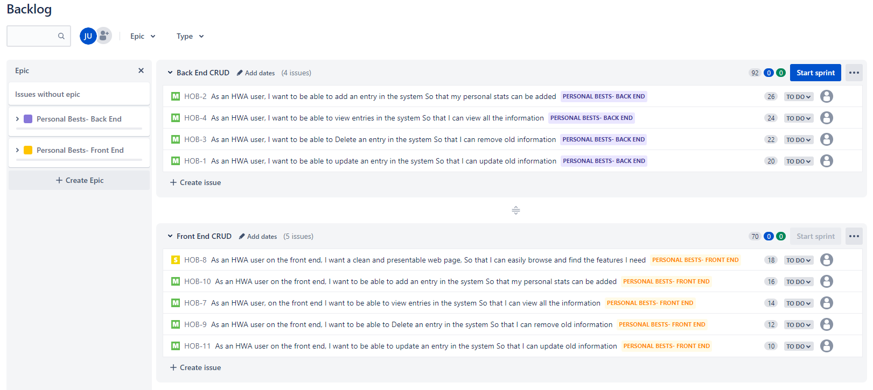
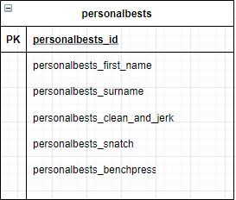
Jira Board & ERD

Slide 4
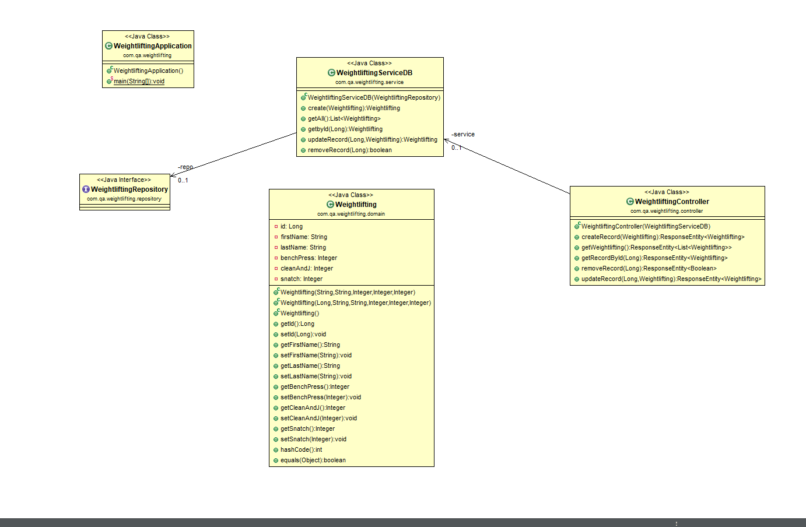
UML DIAGRAM

Slide 5
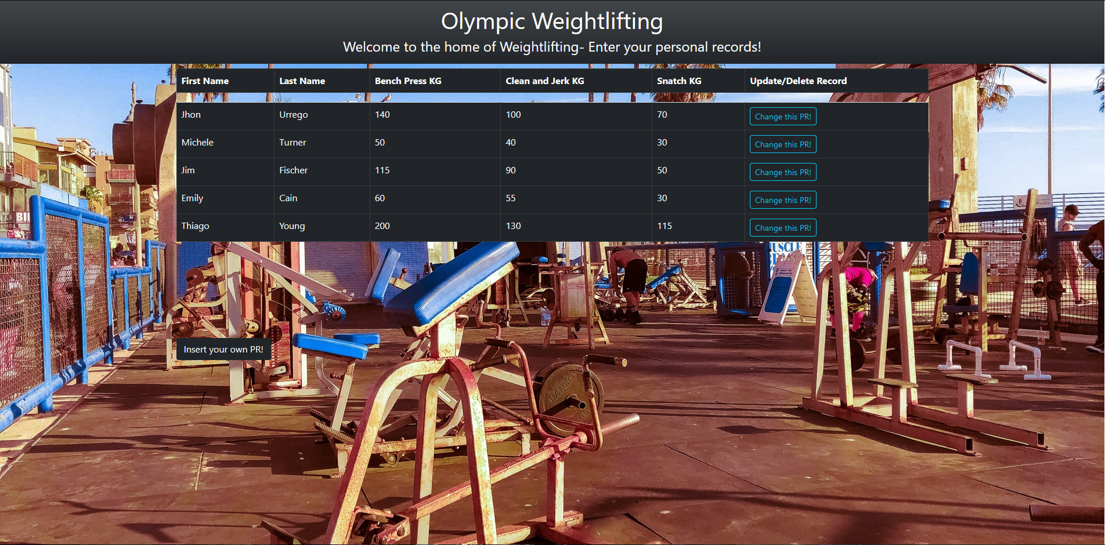
Front End Site

Slide 6
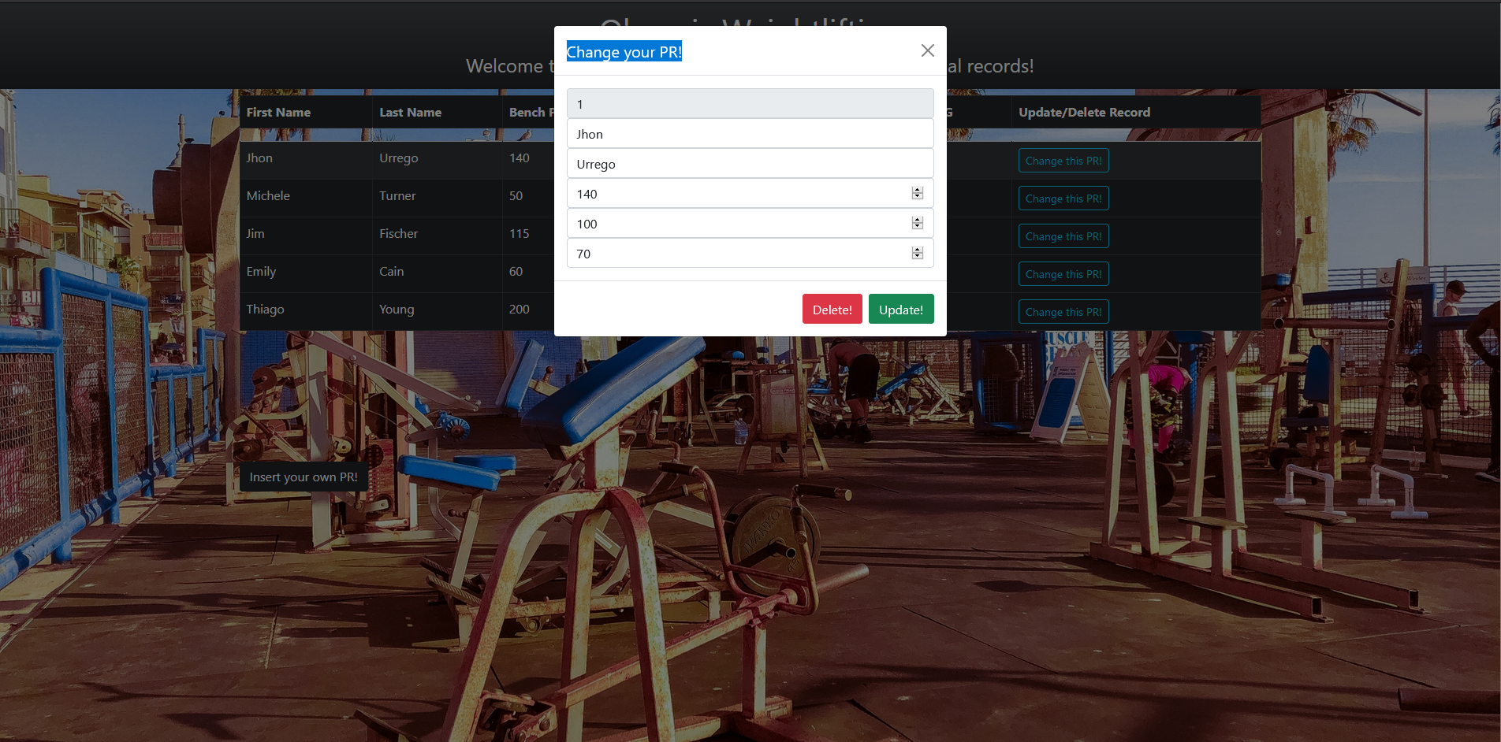
Front End Site

Slide 7
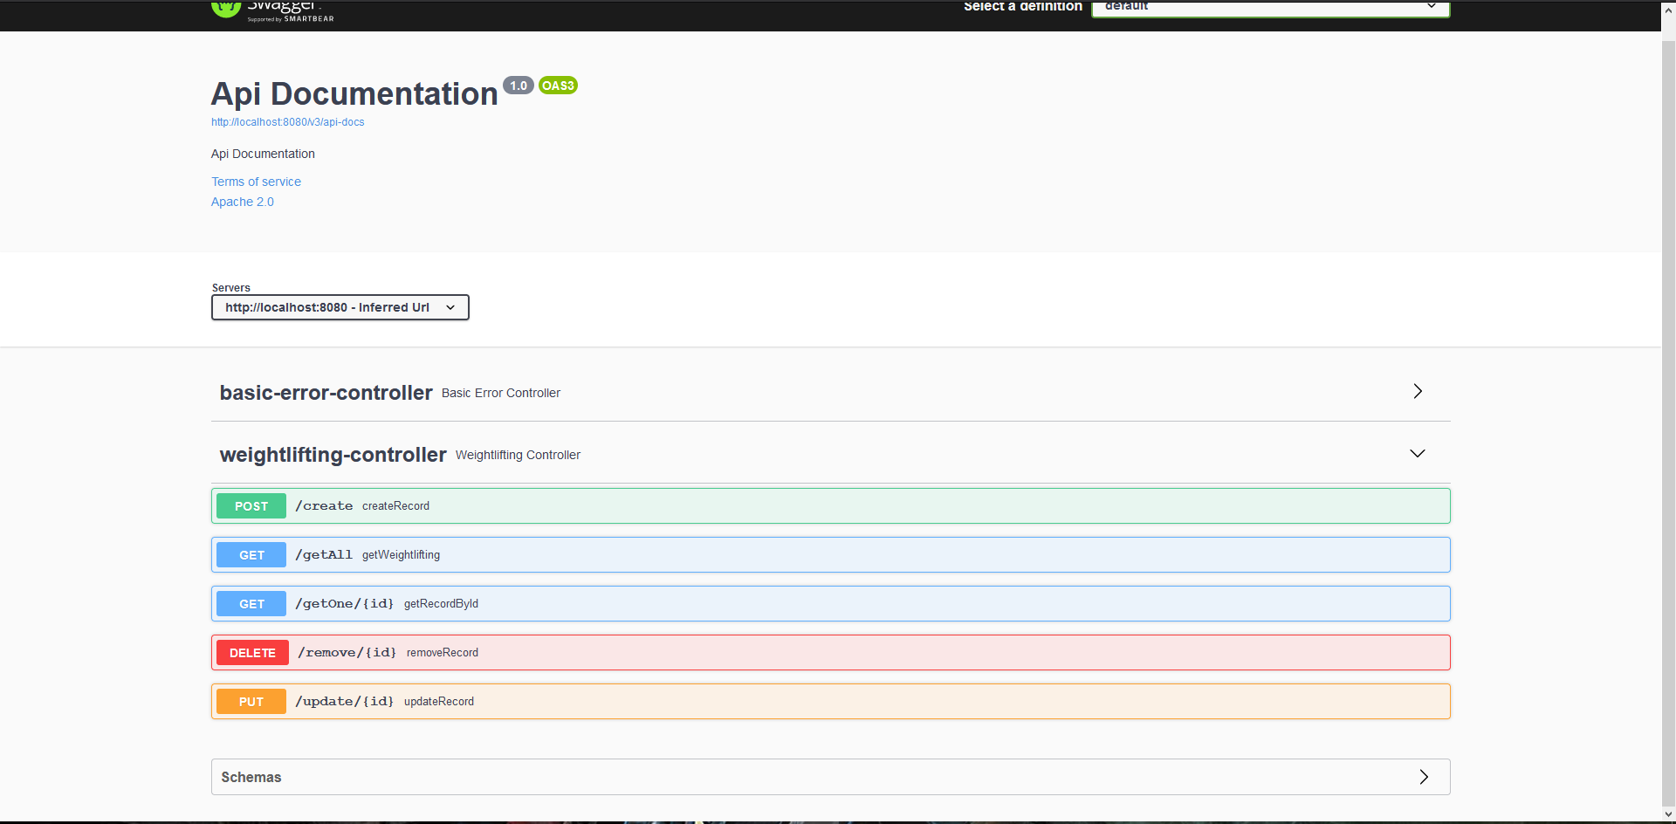
Swagger UI

Slide 8

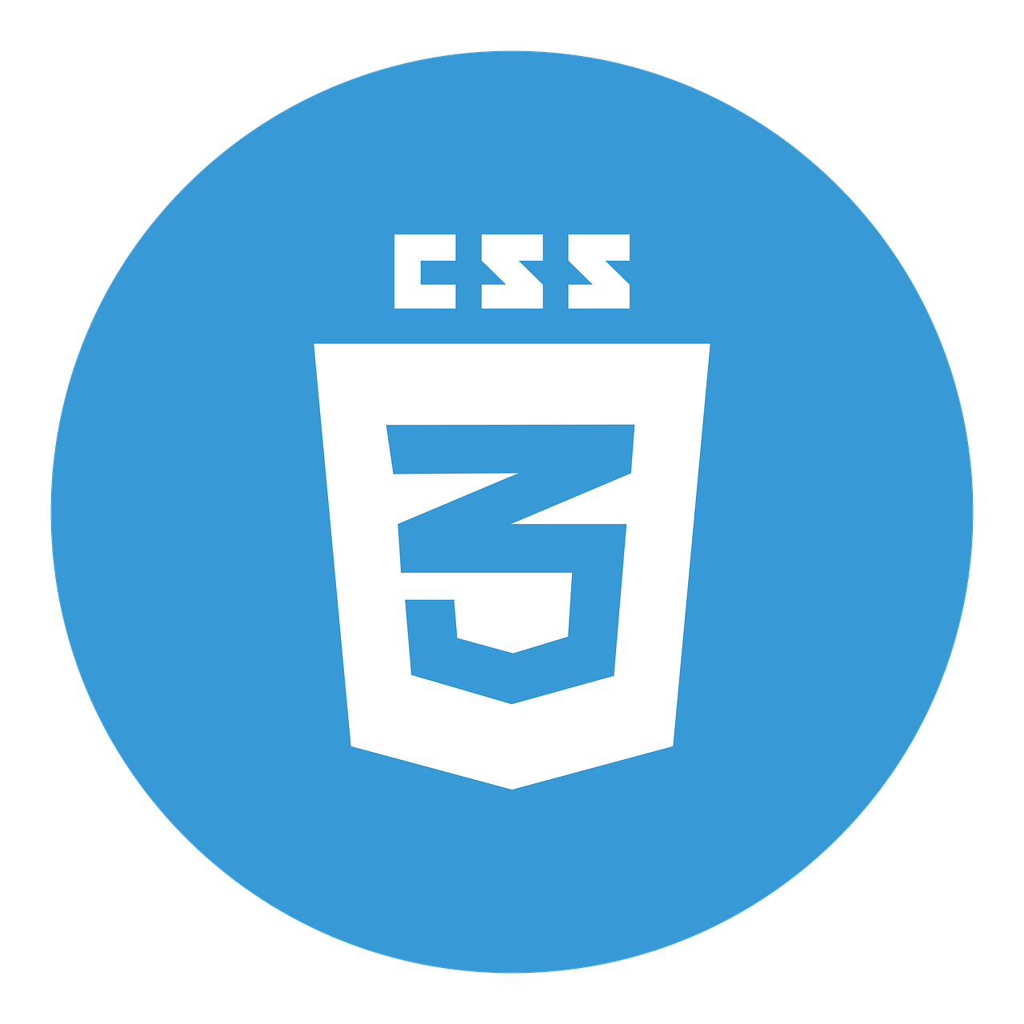
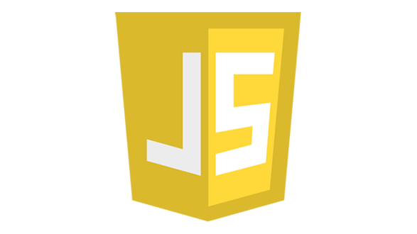


Consultant Journey
Worked with and improved on:
HTML
JavaScript
CSS
Spring
Selenium
Junit
Mockito

Slide 9
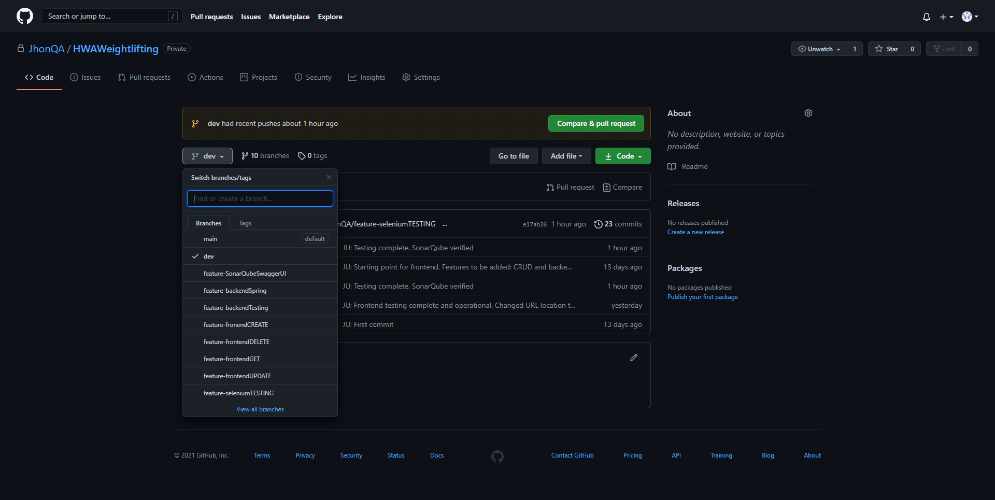
CI
Followed the feature-branch model-

Slide 10
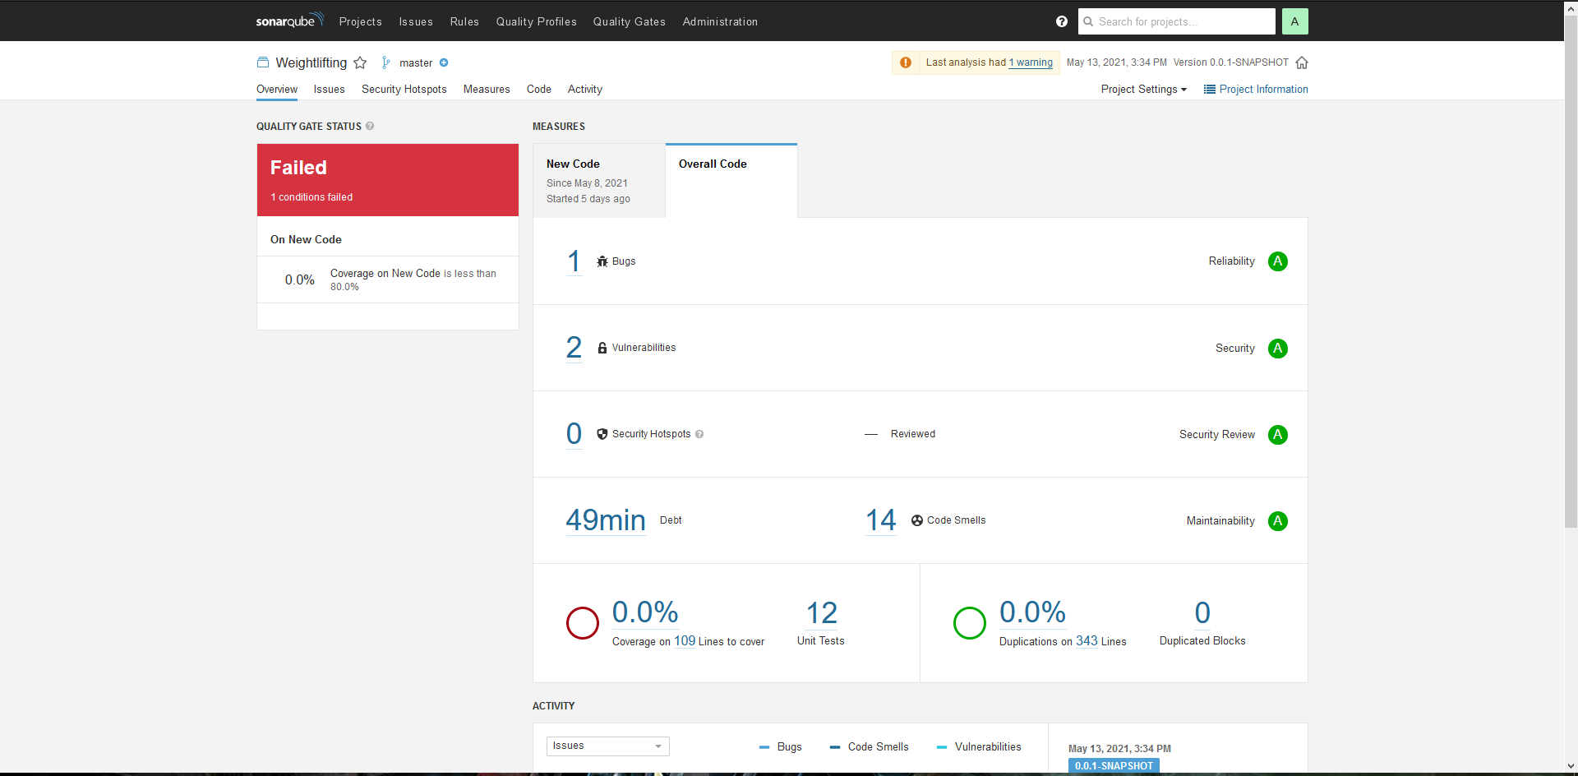
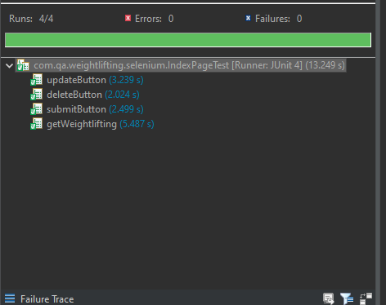
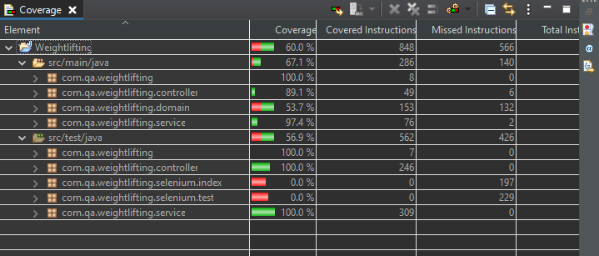
Testing
67% coverage in Main
Mockito and JUnit used for Spring Back-End
Selenium used to test Front-End

Slide 11
Demonstration

Slide 12
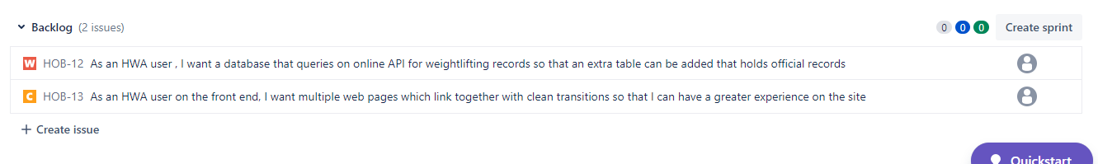
Sprint Review
Completed the Must Haves stated in the Jira board. Meeting the MVP.
Sprints were split in two: Front-End CRUD and Back-End CRUD
Additional stories were made with Could have/Should have prorities.
The front end could have had multiple pages linking to each other. But I left this out to focus on the MVP first.

Slide 13
Sprint Retrospective
What went well?
Breaking down the project and understanding the structure
Improved task prioritization
What Could be improved?
Going back and updating the stories as I was completing the project.
Completing the existing stories more efficiently to give me more space to add new features
Creating new stories for any potential new features

Slide 14
Conclusion
Better understanding of the Multi tier architecture
Learnt how to use JavaScript, HTML and CSS and a higher level to create a Front End
Improved on my back end testing with Junit and Mockito as well as learning a new Front end testing in selenium
In the future I would create more front end pages to improve presentability and to play around with features

